Slide 1


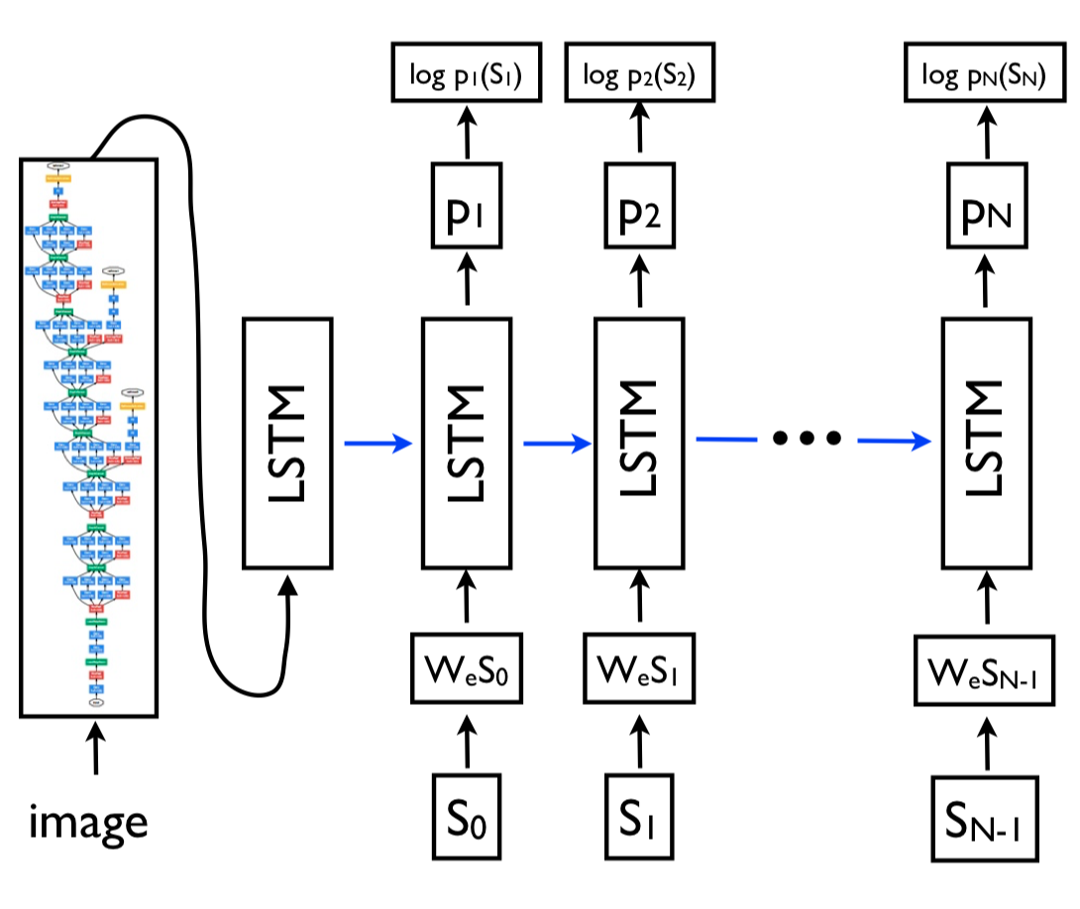
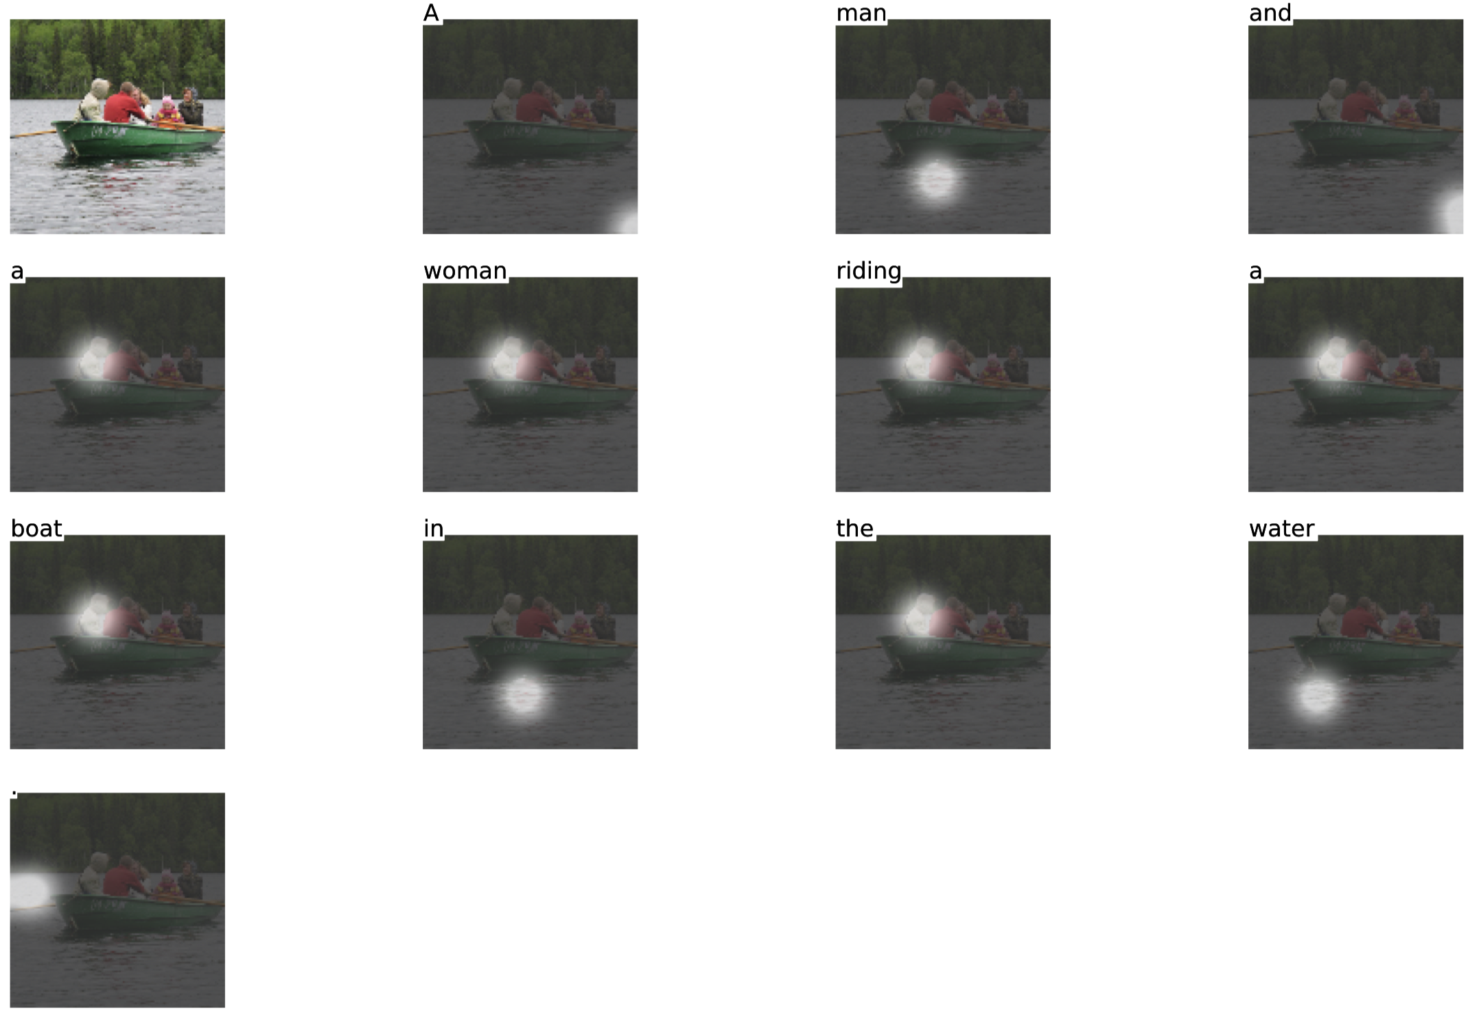
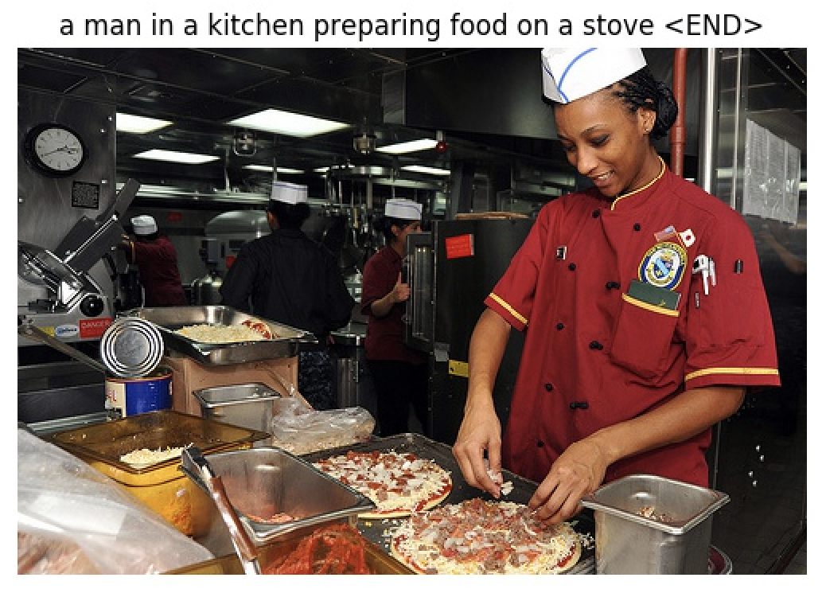
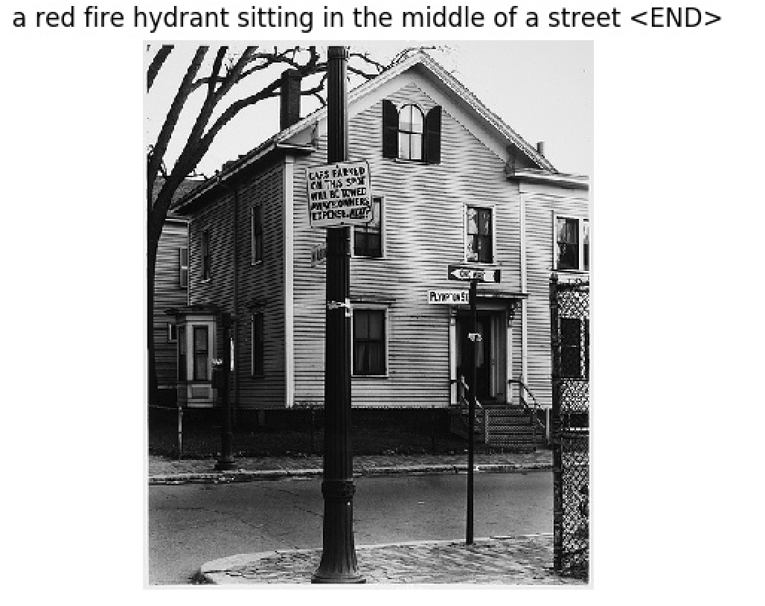
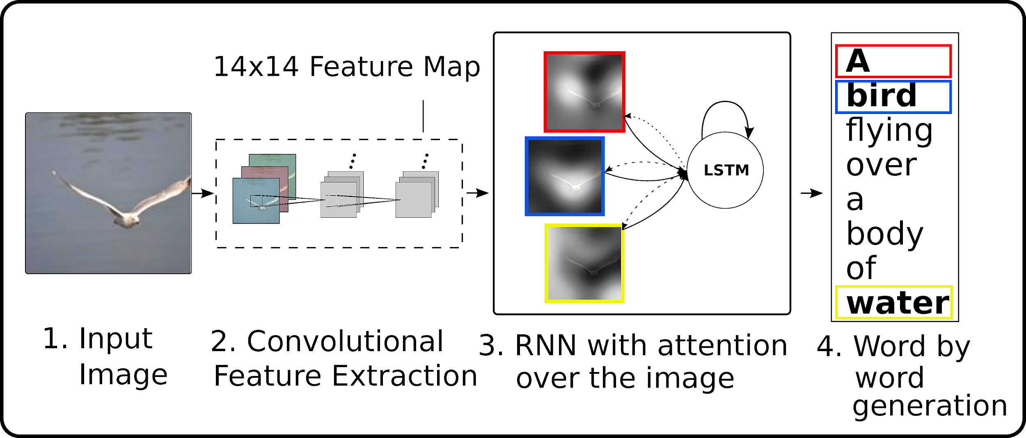
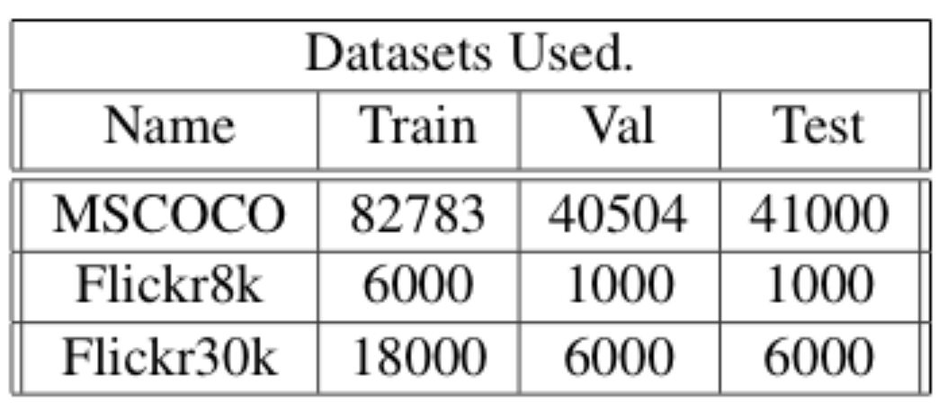
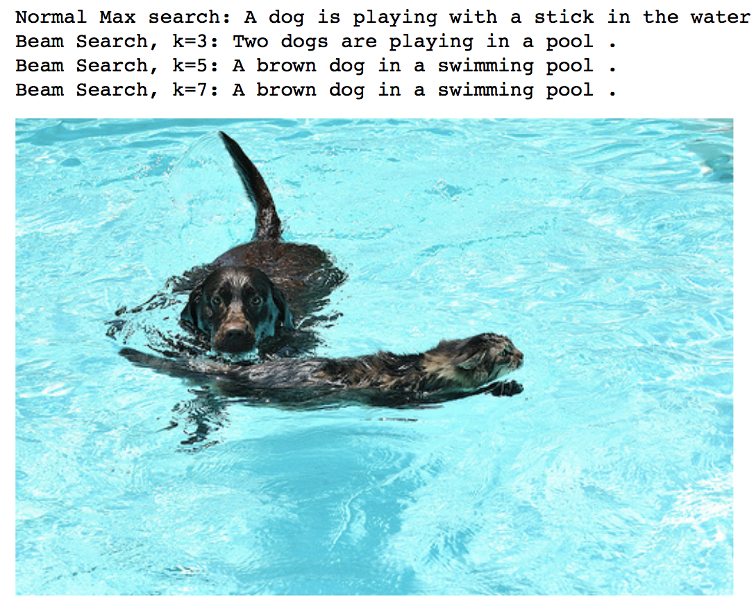
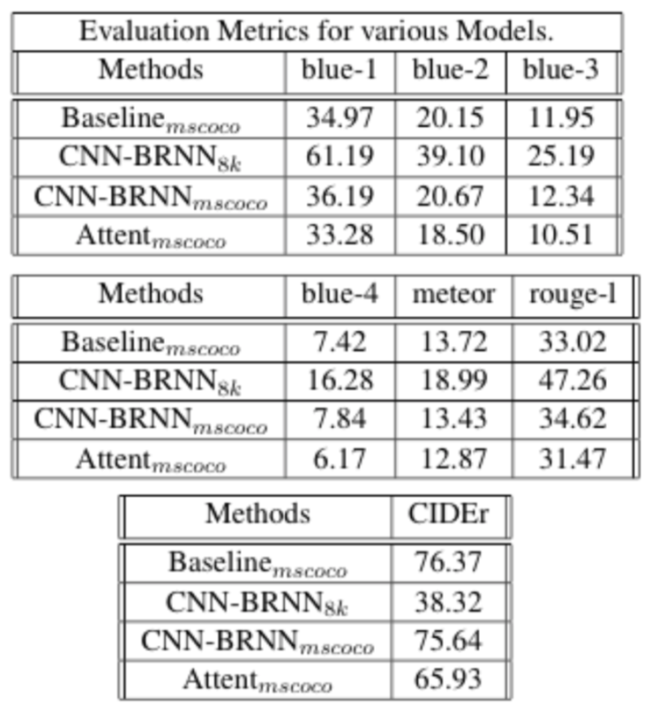
IMAGE CAPTION GENERATION
CSE 628 - NATURAL LANGUAGE PROCESSING
AISHWARYA DANOJI - 111493647 , KIRANMAYI KASARAPU- 111447596 , RAHUL BHANSALI - 111401451
Introduction
Implementation Diagrams
Could not identify if it was a man or a women. Also mistakes the pizza as a stove due to similarity in shapes.
Image Captioning is a fundamental problem in artificial intelligence that connects computer vision and natural language processing. The common approach that has been explored in most of the research is CNN + RNN based models.
Analysis
Motivation
Sentence generated using attention model : A man and a woman riding a boat in the water.
Image captioning task requires mimicking the exceptional human ability to compress huge amount of salient visual information into descriptive language. Also a single image can have multiple correct captions.
Can identify the street but could not identify the object correctly.
Future Work
Use different loss function like NCE.
Sampe some negative words that should not appear in the sentence for a given image.
In CNN-BRNN use multiplicative interactions with image and word embedding rather than additive.
In LSTM model use lower level convolutional features as input to the language generator and compare the results.
Models Implemented
Results
BASELINE - Convolutional Neural Networks are used to encode the image into a fixed length encoding and this encoding is fed as an input to the Recurrent Neural Network which outputs the caption for that image.
GOOGLE NIC - Uses Bidirectional RNN.
ATTENTION BASED - Added attention layer on top of baseline model
Conclusion
We evaluated performance of different models and found that Attention based image captioning gives the best result. We reached State of the Art performances on Flickr8k dataset using CNN-BRNN model.

